Slide 1

REopt: Energy Decision Analysis
NREL REopt Team
reopt.nrel.gov

Slide 2
Contents
REopt Overview
REopt Web Tool
REopt API
REopt Custom Analysis Projects
Additional REopt Information
Appendix: More REopt Projects

Slide 3

The Nation’s Energy Supply Is in the Midst of a Transformation
As costs decrease, renewable energy deployment is growing worldwide.
Generation is increasingly distributed, with 31% of new capacity behind-the-meter.
Distributed energy technologies can provide cost savings, resilience, and emissions reduction.
With increasingly integrated and complex systems, back-of-the-envelope calculations are no longer sufficient to determine distributed energy project potential.
Notes:
For further information regarding the second bullet (31% of new capacity behind-the-meter), see Bloomberg New Energy Finance (2017). New Energy Outlook 2017. New York, NY: Bloomberg New Energy Finance.

Slide 4
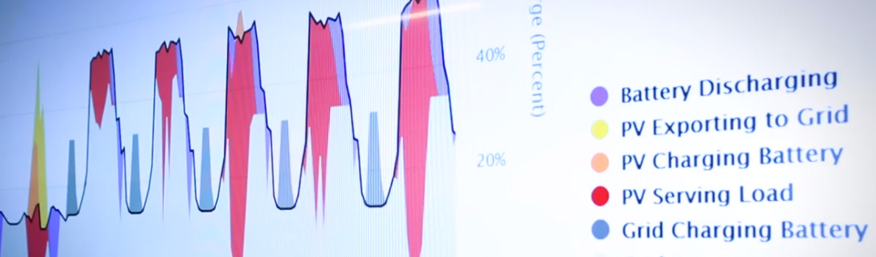
REopt Optimizes Integrated Energy Systems
NREL’s REopt® platform optimizes planning of generation, storage, and controllable loads to maximize the value of integrated systems.
REopt considers electrical, heating, and cooling loads and technologies simultaneously to identify the optimal technology or mix of technologies.
It transforms complex decisions into actionable results for building owners, utilities, developers, and industry.
REopt analysis guides investment in economic, resilient, sustainable energy technologies.

Slide 5






Will Distributed Energy Resources (DERs) Work for Your Site?
Renewable Energy Resource
Technology Costs and Incentives
Site Goals
Utility Cost and Consumption
Financial Parameters
Many factors affect whether distributed energy technologies can provide cost savings and resilience to your site, and they must be evaluated concurrently.

Slide 6


REopt Energy Planning Platform
Formulated as a mixed integer linear program, REopt provides an integrated, cost-optimal energy solution.
Drivers
Goals
Minimize Cost
Clean Energy
Resilience
Economics
Technology Costs
Incentives
Financial Parameters
Energy Costs & Revenue
Energy & Demand Charges
Market Participation
Escalation Rates
Resources
Renewable Generation
Solar PV
Wind
Technologies
Technology Mix
Technology Size
Conventional Supply
Electric Grid & Fuel Supply
Conventional Generators
Combined Heat and Power
Energy Planning Platform
Techno-Economic Optimization
Operations
Optimal Dispatch
Optimized Minimum
Cost Solution
Technology Options
Energy Storage
Batteries
Thermal storage
Project Economics
Capital Costs
Operating Costs
Net Present Value
Geothermal Heat Pumps
Progress Toward
Goals
Emissions Reduction
Length of Outage Sustained
Thermal Loads
Electric Loads
Notes:
Initially developed in 2007, REopt has been used for the past 13 years to guide energy decisions for buildings, campuses, and communities.
It has been continuously updated over time to address the latest questions of our customers—from net zero planning to resilience to integration of flexible loads.
The platform is used as a base, but it is often customized by NREL analysts to address customer-specific questions.
The unique features of the model are integration, optimization, and automation.
Renewable technologies, not all of which are listed in the figure, include solar photovoltaic (PV), wind, biomass, waste-to-energy, landfill gas, ground source heat pumps, solar hot water, and solar ventilation preheating.

Slide 7

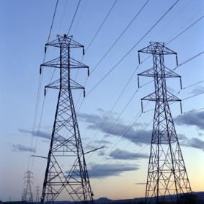



REopt Provides Solutions for a Range of Users
Including researchers, developers, building owners, utilities, and industry
What is the optimal size of DERs to minimize my cost of energy?
How do I optimize system control across multiple value streams to maximize project value?
Where do market opportunities for DERs exist? Now and in the future?
What will it cost to meet my sustainability or renewable energy goal?
What is the most cost-effective way to sustain a grid outage spanning 1 day? What about 9 days? ​
Notes:
REopt can be used to answer detailed questions at a single site (e.g., system size, dispatch, and cost of energy technologies to meet a goal).
REopt can also be run at thousands of sites to answer broader questions about technical and economic viability trends nationwide.

Slide 8
How Does REopt Work?
REopt considers the trade-off between ownership costs and savings across multiple value streams to recommend optimal size and dispatch.
Demand Reduction
Setting peak for the month
Energy Arbitrage
Buy cheap, use high
Monday
Tuesday
Wednesday
Thursday
Friday
Saturday
Sunday
Example of optimal dispatch of PV and BESS
Notes:
REopt finds the size and dispatch strategy for an integrated set of technologies to meet the load in every hour while minimizing the life cycle cost of energy to the site.
This example shows a dispatch strategy for one week. The load is shown in black. The utility grid in grey is meeting most of the load. PV (blue) is meeting some of the load during the daytime. Storage (orange) is filling in at the end of the day as PV production falls off, but utility rates are still high. Together, PV and storage are used to reduce peak demand from the grid from 27 megawatts (MW) to 23 MW. Storage is also used for energy arbitrage, charging when utility prices are low (dark grey) and discharging when they are high.
REopt is looking for the most cost-effective size and dispatch of technologies to meet the load.
A bigger PV+battery system could be built, but the additional savings would not be enough to cover the additional cost.
A smaller PV+battery system could be built, but then savings would be left on the table.
REopt finds the optimal mix between ownership costs and savings.

Slide 9
How Does REopt Evaluate Resilience?
REopt finds the system size and dispatch that minimizes life cycle energy costs for grid-connected operations and survives a specified grid outage. It evaluates thousands of random grid outage occurrences and durations to identify the probability of survival.
Existing generator with fixed fuel supply sustains the critical load for 5 days with 90% probability.
Adding solar and storage to the existing generator increases survivability from 5 to 9 days by extending fixed diesel fuel supplies and provides utility cost savings while grid-connected.
Generator, Solar, and Storage
Generator Only
Notes:
REopt can optimize a system to survive a specified outage period at lowest cost or evaluate the ancillary resilience benefits of a system designed for maximum economic benefit.
In the example above, two alternative systems are shown. A backup diesel generator with a fixed supply of on-site fuel is shown in grey. We assume fuel cannot be resupplied due to disruptions to the supply chain during the outage.
A diesel generator combined with solar and storage is shown in blue.
Adding solar and storage to the diesel generator extends the amount of time the site can survive an outage by extending the fixed fuel supply. Solar and storage allow the diesel generator to turn down or turn off during some hours of the day, saving fuel and extending outage survivability.
Survivability is mapped as a probability because load and solar resource vary throughout the year, so survivability changes depending on the timing of the outage.

Slide 10
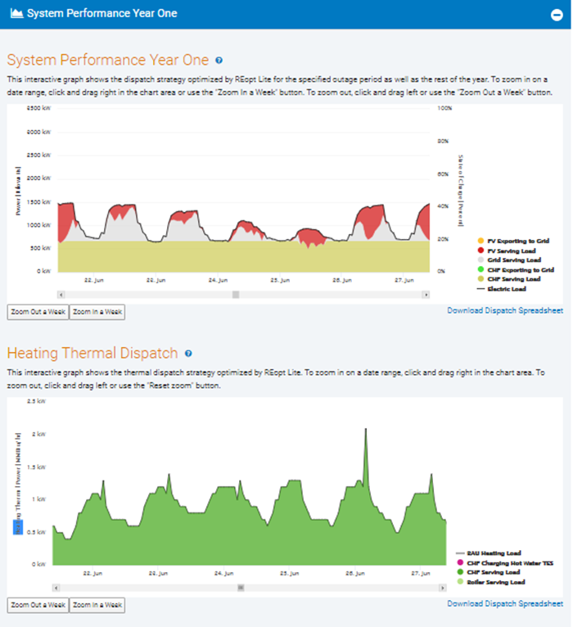
Thermal Technologies in REopt
In addition to solar PV, wind power, and battery energy storage systems (BESS), REopt includes combined heat and power (CHP), geothermal heat pumps (GHP), absorption chillers, and thermal energy storage (TES).
These technologies enable analyses of electric and thermal loads together:
  Simultaneously serving heating and electricity loads with CHP
  Switching from heating with fuels to electricity with GHP
  Switching from generating cooling with electricity to heat with an absorption chiller
  Value of decoupling thermal loads from thermal energy production with TES.

Slide 11

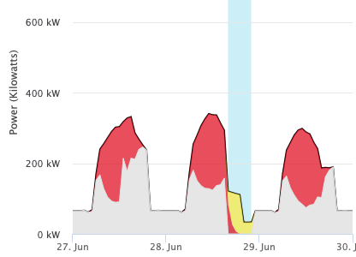
Emissions in REopt
REopt determines the emissions and emissions cost impacts of a DER investment, accounting for the hourly emissions intensity of grid electricity as well as on-site fuel consumption.
Using REopt, users can:
Quantify emissions changes and the monetary impact of emissions reductions on climate (CO₂) and health (NOx, SO₂, PM2.5) outcomes
Set a climate emissions reduction target and allow REopt to determine the cost-optimal DER investment to meet the target
Include climate and/or health costs within the optimization objective, allowing these costs to impact system sizing and dispatch
Use locational default emissions rates and costs or input custom values
Evaluate health and climate emissions over the project life, considering future “greening of the grid.”
Avoided emissions
Grid emissions [tons] =
Electric grid purchases [kWh]
x
Marginal emissions intensity [ton/kWh] of the grid (location-specific) in each hour
Fuel emissions [tons] =
Fuel burned on-site [gal]
x
Fuel emissions intensity [ton/ gal]
Currently, REopt uses the following defaults:
Grid emissions rates: marginal rates calculated from EPA’s AVERT
Grid emission rate change projections: calculated from NREL’s Cambium
Climate costs: U.S. Interagency Working Group 2021 social cost of carbon
Health emissions costs: location-specific, obtained from EASIUR model
Notes:
Example questions REopt can help answer:
How could adding DERs impact my site’s emissions? What are the climate and health costs savings of these emissions reductions?
How does considering climate and health-related emissions costs impact cost-optimized DER system sizes and dispatch at my site?
What DER system sizes/dispatch could most cost-effectively reduce my site’s emissions by x%?
Users can:
View the change in climate (CO2) and health (NOx, SO2, and PM2.5) emissions and the change in the associated climate and health costs of the recommended DER investment (in year 1 and over the lifetime of the investment)
Set an emissions reduction target and allow REopt to determine the cost-optimal DER investment to meet that target
Include climate and/or health costs of emissions within the optimization, allowing these costs to impact system sizing and dispatch strategies
Use default values for emissions rates and costs or input custom values
Choose to exclude exported electricity as an emissions offset (by default it is considered an emissions offset)
Current default details (as of Jan 2022):
Hourly marginal CO₂, PM_{2.5}, NO_{x}, and SO₂ emissions are from EPA’s AVERT, at AVERT’s regional scale
The default projected annual percent decrease in grid emissions factors (1.174%/year) is calculated as the U.S. national average percent decrease in short-run marginal CO2 emissions from 2020-2046 based on data from NREL’s Cambium Mid-Case scenario (Gagnon, Frazier, Hale, & Cole, 2020).
Similar forward-projected emissions factors do not yet exist for health emissions (NOx, SO2, and PM2.5) and we thus use the CO2 annual change to approximate the annual percent decrease for health- related emissions.
Health emissions costs and escalation rates automatically update with site location. Obtained from EASIUR model (36x36km resolution covering the continental US)
Default social cost of CO₂ ($51/t) and escalation rate (4.22%) from U.S. Interagency Working Group 2021

Slide 12

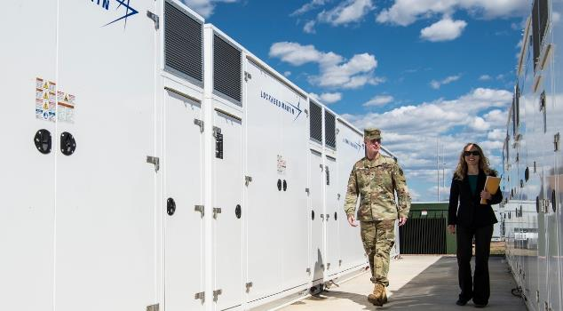
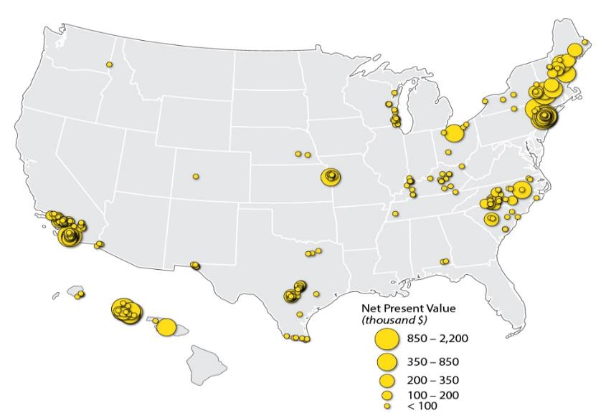
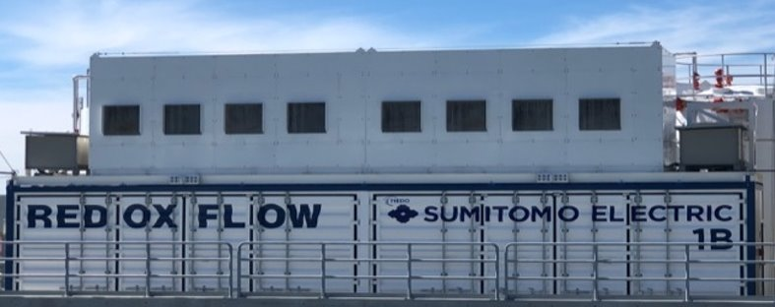
Informing Deployment
REopt helps partners make well-informed energy investment decisions backed by credible, objective data analysis by answering questions such as:
How should DERs be sized to minimize site energy costs, achieve a renewable energy or emissions reduction target, and/or provide resilience value?
How should I dispatch these technologies to maximize their value?
What is the value (or net present value) of a project?
Alcatraz PV-battery-diesel hybrid system completed in 2012. NREL provided technical assistance to optimize the dispatch.
Ft. Carson 4.25 MW/8.5 MWh peak-shaving Li-ion BESS completed in 2019. NREL provided technical assistance to validate the $0.5 million/year savings.
Identified cost-effective renewable energy and microgrid projects to meet Time Warner Cable energy goals for reduced energy use, reduced energy cost, and increased resilience.
San Diego Gas & Electric and Sumitomo partnered with REopt team to develop daily dispatches for front-of-the-meter flow battery in SDG&E territory.

Slide 13
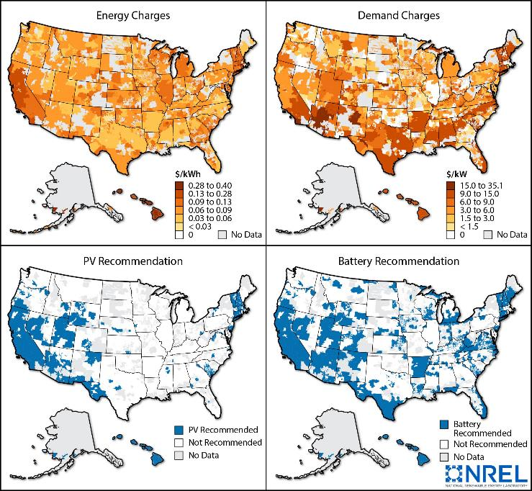
Project Economics at National Scale
REopt enables national-scale analysis of renewable energy and storage economics and impacts on deployment
Analysis questions include:
  Where in the country is solar PV, storage, and CHP currently cost-effective?
  At what capital cost is storage adopted across the United States?
  Under what conditions (utility rate, load profile, location) can renewable energy and storage provide cost savings and resilience benefits for commercial buildings?
  How do varying utility rates, projected costs, and incentive structures impact storage profitability?
  How do I prioritize projects across a portfolio of sites with varying energy costs and use, renewable energy resources,
  and land availability?
NREL explored solutions for increasing affordability of DC fast charging (DCFC) nationwide through pairing with solar, storage, and building loads.

Slide 14
Accessing REopt
The REopt team works with stakeholders to provide a suite of trusted techno-economic decision support services to optimize energy systems for buildings, campuses, communities, microgrids, and more.
The team also develops publicly available REopt software; capabilities developed by the team are transferred to REopt based on broad use and validation, customer needs, and available funding.
REopt Decision Support Services
Allows organizations to work closely with NREL’s team of experts on customized analysis, answering complex energy questions using an expanded set of internal modeling capabilities.
REopt Software
Developed by the REopt team, the tool guides users to the most cost-effective or resilient PV, wind, CHP, and battery storage options at no cost to users. Available via web tool, application programming interface (API), and open source.
NREL. “REopt Web Tool.” Accessed March 2022. https://reopt.nrel.gov/tool.
NREL. “REopt API V1.” Accessed March 2022. https://developer.nrel.gov/docs/energy-optimization/reopt/v1/.
GitHub. “NREL/REopt_API.” Accessed March 2022. https://github.com/NREL/REopt_API.

Slide 15
REopt Capability Development
REopt API and Open Source
Additional features with longer runtime
Customizable
REopt Web Tool
REopt Custom Analysis and Development
Easy-to-use web access
Key standardized capabilities
New feature development
Supports specific customers
Tool integration
Capabilities developed by the team are transferred to REopt based on broad use and validation, customer needs, and available funding.
Notes:
The REopt team provides a suite of trusted techno-economic decision support services and software to optimize energy systems for buildings, campuses, communities, microgrids, and more.
The team also develops publicly available REopt software; capabilities developed by the team are transferred to REopt based on broad use and validation, customer needs, and funding available.

Slide 16
REopt Web Tool
User Interface and Key Results

Slide 17

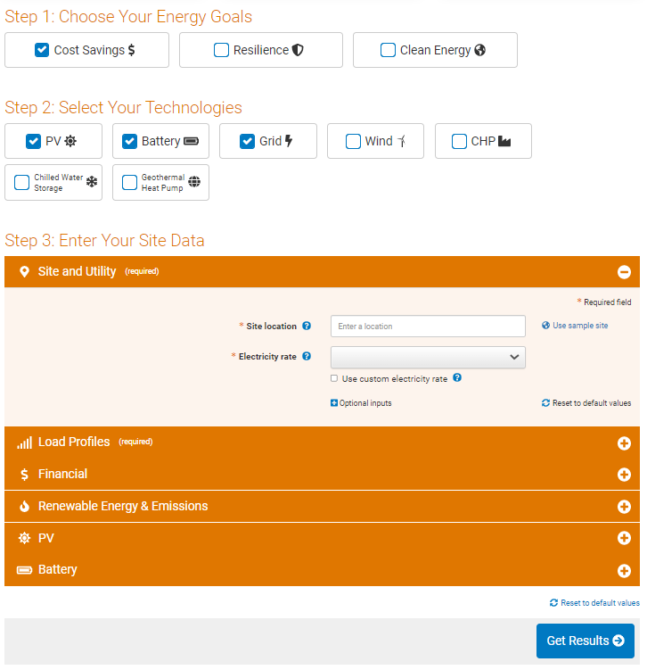
REopt Web Tool User Interface
REopt Web Tool offers a free, publicly available, user-friendly web tool that offers a subset of NREL's more comprehensive REopt model
Optimizes PV, wind, CHP, GHP, and energy storage system sizes and dispatch strategies to minimize life cycle cost of energy
Resilience mode optimizes PV, wind, and storage systems, along with backup generators, to sustain critical load during grid outages.
Clean energy goals allow users to consider renewable energy targets, emissions reductions targets, and emissions costs in optimization
Access REopt web tool at reopt.nrel.gov/tool.

Slide 18
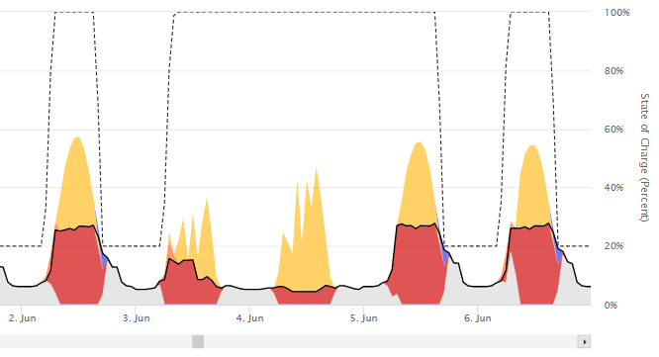
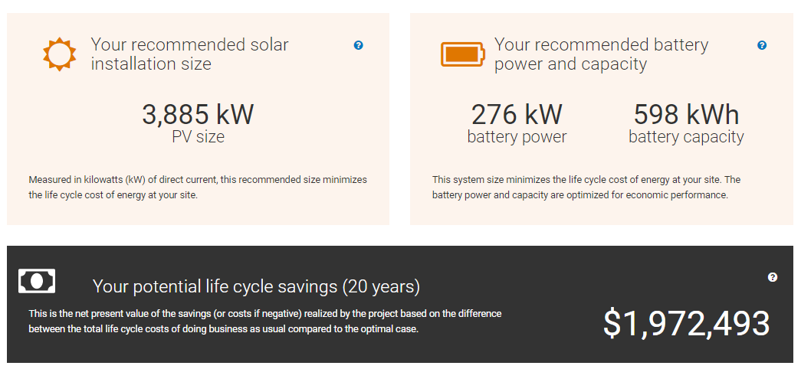
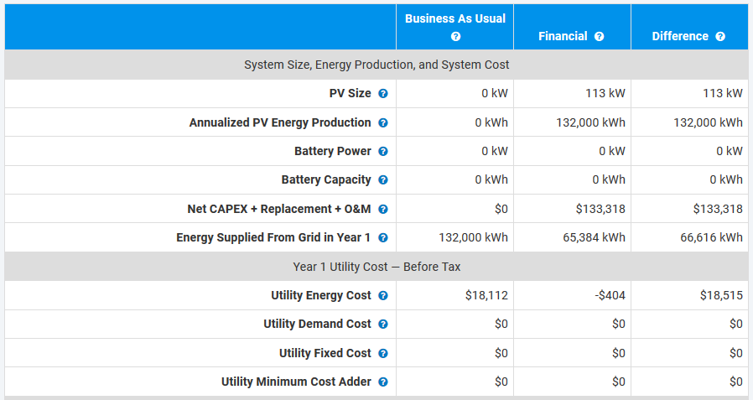
REopt Web Tool Key Outputs
Hourly Dispatch
System Size and NPV
Detailed Financial Outputs

Slide 19
REopt API

Slide 20
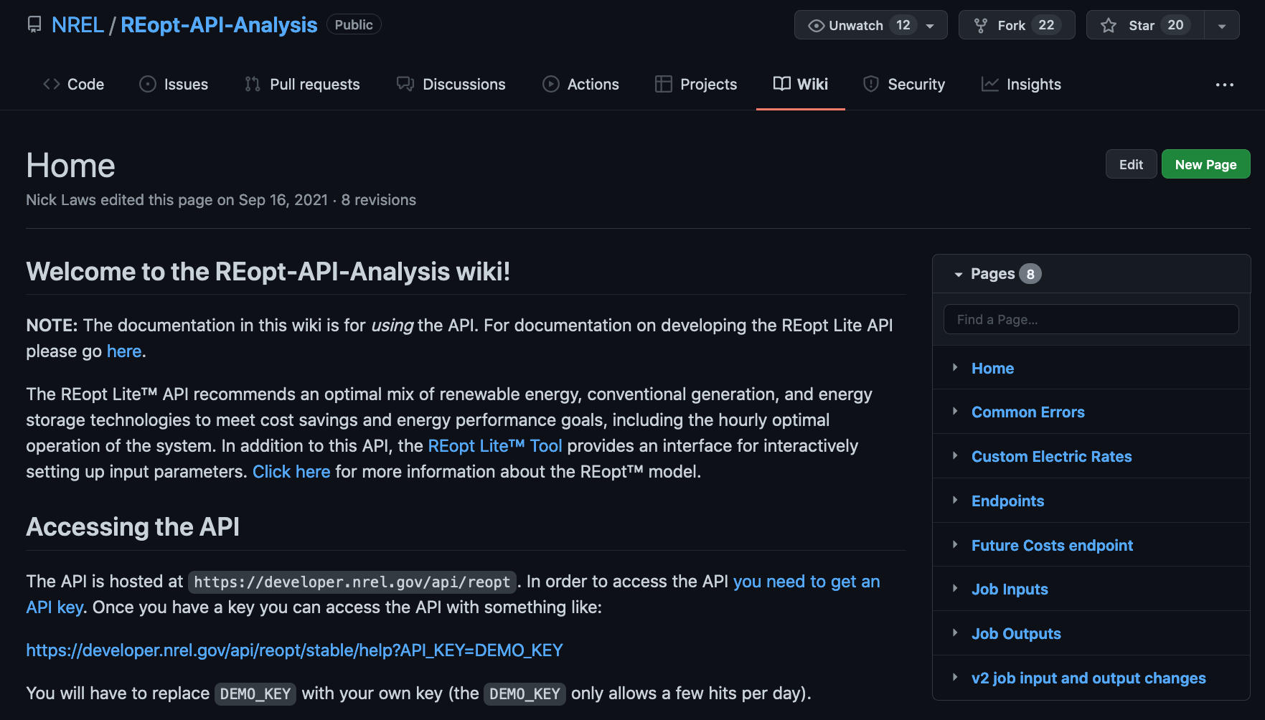
REopt API Access
What is an API?
  Application Programming Interface
  Programmatic way of accessing REopt web tool (sending and receiving data from a server)
  File format used for sending and receiving the data: JSON.
Advantages:
  Multiple simulations for different sites can be run programmatically
  Scenario analysis can be automated
  Application can be integrated with other programs.
https://github.com/nrel/reopt-api-analysis/wiki

Slide 21
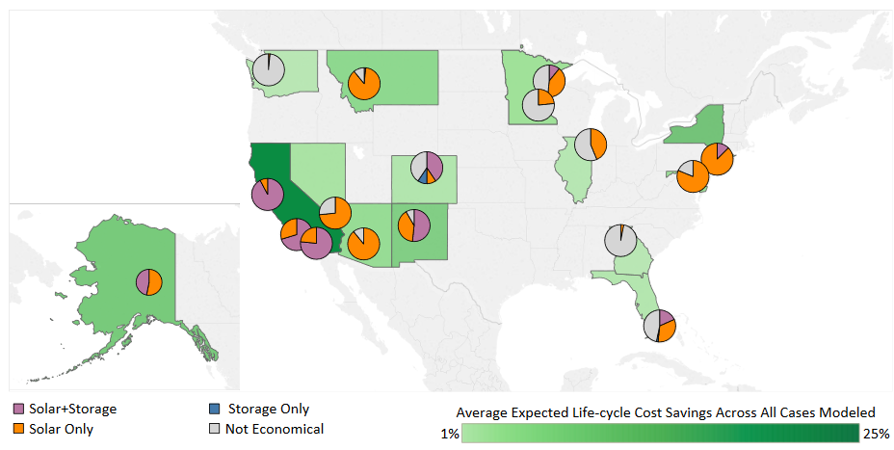
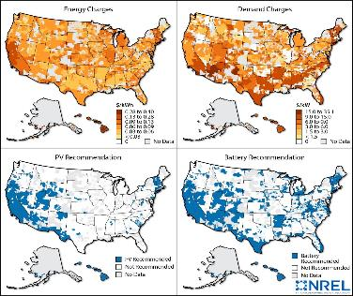
Analysis Enabled by API
The REopt API enables national-scale analysis of storage economics and impacts on adoption/deployment.
Analysis questions include:
  Where in the country is storage (and PV) currently cost-effective?
  At what capital costs is storage adopted across the United States?
  How does varying utility rate, escalation rates, and incentive structures impact storage profitability?
  How (and where) can stationary storage support DCFC electric vehicle economics and deployment?
Identifying critical factors in the cost-effectiveness of solar and battery storage in commercial buildings: https://www.nrel.gov/docs/fy18osti/70813.pdf
Technology solutions to mitigate electricity cost for electric vehicle DCFC: https://www.sciencedirect.com/science/article/pii/S0306261919304581

Slide 22
REopt Custom Analysis Projects

Slide 23
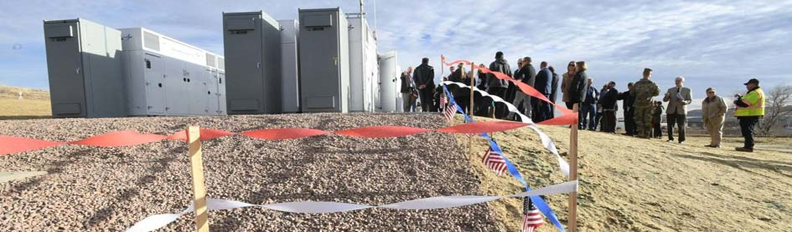
Value of Behind-the-Meter Storage at Fort Carson
Description: NREL used REopt to independently verify the predicted utility savings estimated by the project developer from battery peak shaving.
Technology: Li-ion battery storage
Impact: 4.2 M; 8.5-MWh battery installed at Ft. Carson under an energy savings performance contract. Largest battery in the Army at time of installation, saving Ft. Carson $500,000 per year in utility costs.
Partner: Army, AECOM
    NREL. “Energy Systems Integration Newsletter: July 2019.” Accessed April 22, 2020. https://www.nrel.gov/esif/esi-news-201907.html.
    NREL. “NREL’s REopt Helps Fort Carson Save Big.” Accessed April 22, 2020. https://reopt.nrel.gov/projects/case-study-ft-carson.html.
Notes:
REopt evaluates rate tariffs and markets to identify economic opportunities for storage.
At Fort Carson, an Army base in Colorado, REopt was used to validate expected savings from deployment of a 4.2-MW, 8.5-megawatt-hour (MWh) battery for peak demand management.
This is the largest peak-shaving battery in the U.S. Department of Defense (DoD).
This was implemented under an energy savings performance contract, significantly reducing risk to the Army. The performance contract guarantees the battery will last for 20 years with no more than 22% degradation.

Slide 24

Field Validation of Utility-Scale Storage Value Streams
Description: NREL validated the technical and economic feasibility
of an emerging vanadium flow battery technology through loss modeling, characterization, and field test.
Technology: High-fidelity vanadium flow battery
Impact: Identified value streams through the application of utility-scale vanadium redox flow battery for local grid support use cases
Partners: Sumitomo and SDG&E
    Adarsh Nagarajan et al. Value Streams from Distribution Grid Support Using Utility-Scale Vanadium Redox Flow Battery: NREL-Sumitomo Electric Battery Demonstration Project. Golden, CO: NREL. August 2018. https://www.nrel.gov/docs/fy18osti/71545.pdf.
Notes:
A loss model was generated using artificial neural networks (ANN) to learn the loss data from testing and then implemented in REopt via special ordered sets (SOS type II).
The team created a rolling model predictive control approach to evaluate bidding strategies into the California Independent System Operator (CAISO) energy and ancillary services markets (the focus was on the energy markets: day-ahead [DA], 15-min., and real-time [RT]).
This optimal approach was compared with the revenue generated from San Diego Gas & Electric’s (SDG&E) bidding. They were using a standard round-trip efficiency approach and heuristic algorithms for the bidding.
Improvement approaches were suggested for increased revenue from bidding.

Slide 25
Design Trade-Offs between Economics and Resilience
Description: NREL used REopt to evaluate how long existing and proposed backup energy systems could sustain the critical load during an outage at an Army National Guard base. REopt evaluated thousands of random grid outage occurrences and durations and compared hours survived with diesel gensets vs. gensets augmented with PV and battery.
Technology: Solar, storage, diesel generation
Impact: PV and battery can provide savings and resilience. Site can achieve 4 extra days of resilience with no added cost.
Partner: Army National Guard
 | Generator | Solar PV | Storage | Lifecycle Cost | Outage
1. Base case | 2.5 MW | - | - | $20 million | 5 days
2. Lowest cost | 2.5 MW | 625 kW | 175 kWh | $19.5 million | 6 days
3. Proposed system | 2.5 MW | 2 MW | 500 kWh | $20 million | 9 days
Kate Anderson et al. Increasing Resiliency Through Renewable Energy Microgrids. Exton, PA: Journal of Energy Management. August 2017. https://www.nrel.gov/docs/fy17osti/69034.pdf.
Notes:
An Army National Guard base in California was considering a PV+battery project to provide economic savings. They were interested in understanding the potential resilience benefit the system could provide.
The site currently purchased all their power from the utility, at a lifecycle cost of $20M over 20 years. They also had an existing 2.5 MW of diesel generator capacity with 4,500 gallons of fuel for backup power on site.
REopt was used to evaluate two alternative options.
In the lowest-cost scenario, shown in green, we found that a 625-kilowatt (kW) PV system and 175-kilowatt-hour (kWh) battery could save the Army $0.5 million over the 20-year analysis period, and as an ancillary benefit, would also provide an additional day of survivability by turning off or ramping down diesel generators in some hours to extend the fixed diesel fuel supply.
In the proposed system scenario, shown in blue, we increased the size of the PV+storage system to 2 MW of PV and 500 kWh of storage. The Army no longer saved any money, but did not lose any money either. This system would provide 4 extra days of resilience.
This analysis informed the cost-benefit analysis for the Army. Would they rather have $500K of savings and 1 extra day of resilience, or no savings, but 4 extra days of resilience?
This helped the Army quantify the resilience benefit of the PV+storage system and think through how much resilience was worth to them.

Slide 26
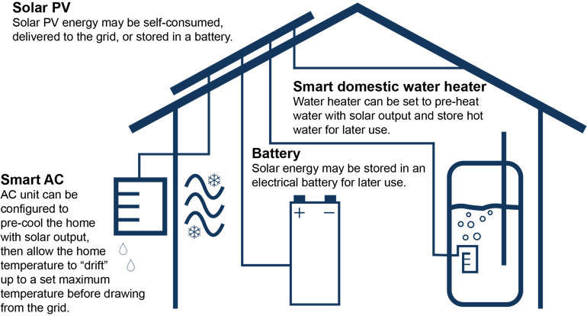
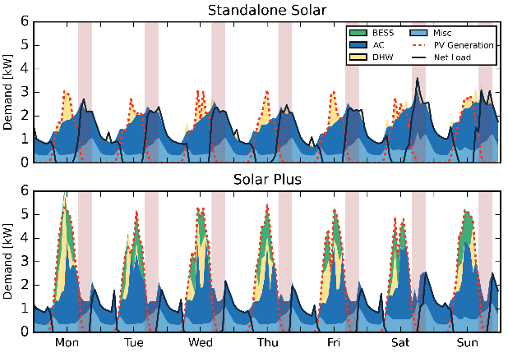
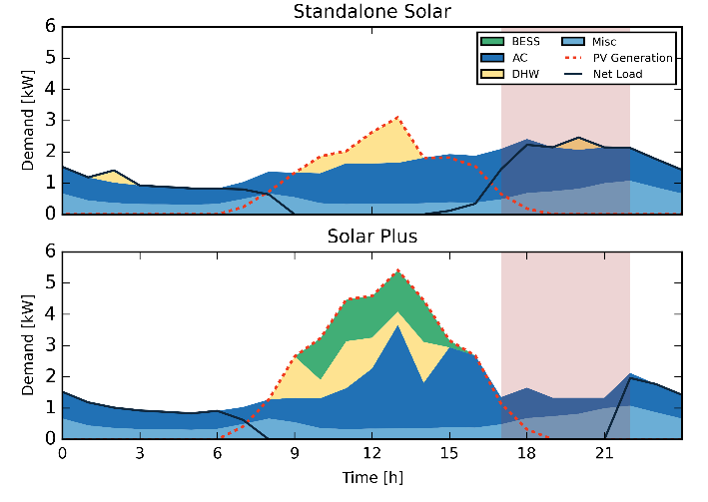
Aligning Generation and Load With Storage and Demand Flexibility
Description: NREL evaluated controllable load and storage options to improve customer economics of solar under post-net metering utility tariffs.
Technology: Solar, storage, buildings
Impact: Flexible loads increase the value of solar by aligning generation to load to maximize value.
Partner: DOE Solar
O'Shaughnessy, Eric, Dylan Cutler, Kristen Ardani, Robert Margolis. Solar Plus: Optimization of Distributed Solar PV through Battery Storage and Dispatchable Load in Residential Buildings. United Kingdom: Applied Energy, March 2018. https://doi.org/10.1016/j.apenergy.2017.12.118.
Notes:
Note how the flexible load (with water heating shown in yellow, air conditioning in blue, and battery charging in green) moves under the solar curve. This allows for a larger, cost-effective PV system combined with a storage system.
This specific example is modeled against Hawaii’s ‘self-supply’ tariff.
A detailed, “white box” model of the thermal envelope was developed based on house construction elements. This model calculates the resistance and capacitance of the different structural components and creates an RC-equivalent circuit model of the home. This is converted into a state space representation where REopt can then determine when/how much energy should be injected into the space node to keep the temperature within its comfort constraints.

Slide 27
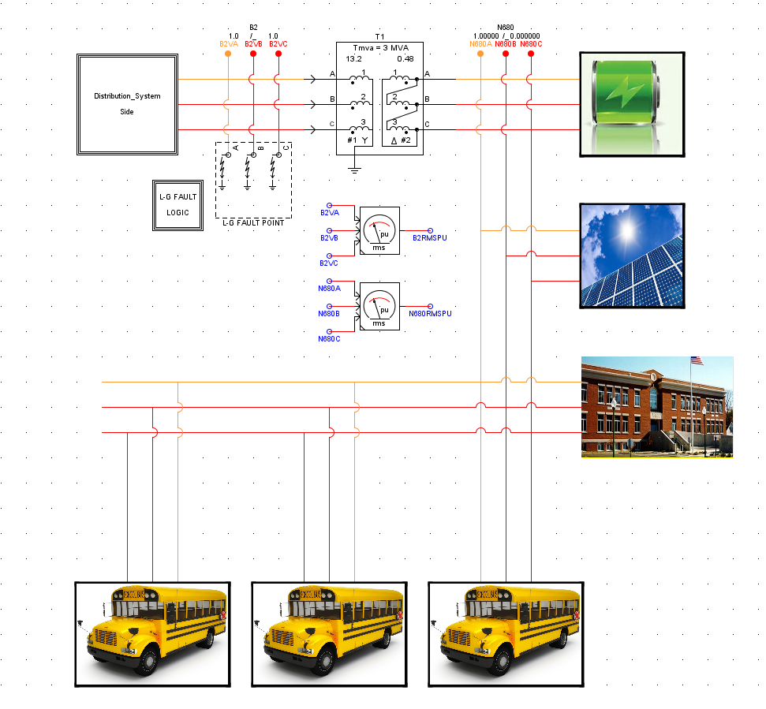
Integrating EV Fleets With DER and Grid
Description: NREL evaluated opportunities for synergistic integration and control of electrified transportation fleets with flexible buildings loads, renewable energy, and stationary storage.
Technologies: Mobility, storage, buildings, solar, advanced system integration controls
Impact: Demonstrated optimal control of integrated renewable energy, building loads, storage, and EV system in laboratory testing. Integrated system provided increased value to the site owner.
Partners: Eaton (funding partner), Holy Cross Energy, SDG&E, Duke Energy, UPS, EPRI
Grid
William Becker et al. Cost Reduction of School Bus Fleet Electrification With Optimized Charging and Distributed Energy Resources. Wichita, KS: North American Power Symposium. October 13–15, 2019. https://www.nrel.gov/docs/fy20osti/74187.pdf.
Notes:
NREL worked with Eaton to model an integrated system of flexible building loads, solar, stationary storage, and electric buses at schools in 3 locations.
We evaluated whether the batteries in the electric buses could be used to provide demand management, grid services, and resilience when the buses were parked.
We found that the buses could provide cost savings for the site owner, especially in areas that have high demand charges and high-value grid service markets.
The optimal REopt dispatch strategy was programmed into an Eaton controller and optimal control of the integrated system was demonstrated in laboratory testing.
Future work may expand this concept to other owners with large fleets, such as package delivery companies.

Slide 28
Additional REopt Information
REopt Technical Description
REopt Curriculum
REopt Journal Articles
REopt Team

Slide 29
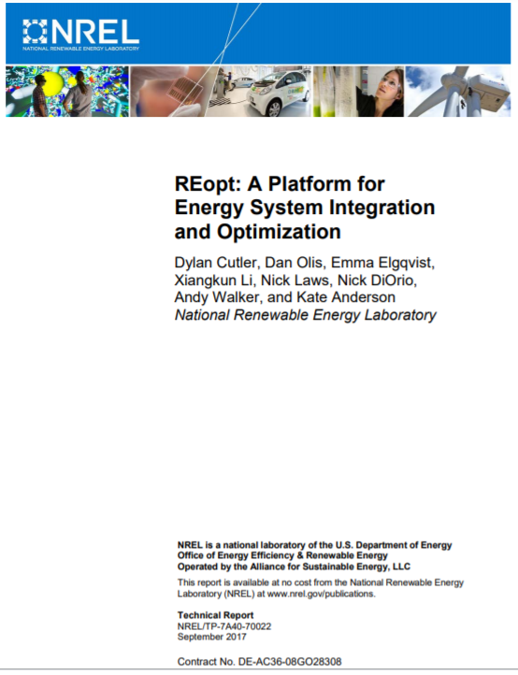
REopt Model Technical Description
Mixed Integer Linear Program
  Mathematical model written in the MOSEL programming language solved using commercial FICO Xpress solver
  Analysis typically requires significant site-specific and client-requested customizations.
Solves energy balance at every time step for entire year (typically 15-minute or hourly interval)
  Load must be met from some combination of grid purchases, on-site generation, or discharge from storage.
  Typically does not consider power flow or transient effects
  Has perfect prediction of upcoming weather and load
  Assumes all years in analysis horizon are the same (typically 25 years).
Technology modules based on empirical operating data
Finds optimal technology sizes (possibly 0) and optimal dispatch strategy subject to resource, operating, and goal constraints:
  Objective function is to minimize life cycle cost of energy
  Resulting life cycle cost is guaranteed optimal to within a known gap (typically 0.01%) subject to modeling assumptions.

Slide 30

REopt’s Impact with Academia
REopt Web Tool Curriculum Materials
  REopt is being used in higher education such as Colorado School of Mines’ Advanced Energy Systems graduate program and DOE’s Solar District Cup to train the next generation of energy professionals.
  Educators can access materials at reopt.nrel.gov/curriculum.html.

Slide 31
REopt Journal Articles
“Looking beyond bill savings to equity in renewable energy microgrid deployment.” Renewable Energy Focus, June 2022.
“Off-design modeling of a microturbine combined heat & power system.” Applied Thermal Engineering, February 2022.
“Optimizing Design and Dispatch of a Renewable Energy System with Combined Heat and Power.” Optimization and Engineering, January 2022.
“Optimizing Solar-Plus-Storage Deployment on Public Buildings for Climate, Health, Resilience, and Energy Bill Benefits.” Environmental Science & Technology, September 2021.
“Resilience and Economics of Microgrids with PV, Battery Storage, and Networked Diesel Generators.” Advances in Applied Energy, August 2021.
“Optimality versus Reality: Closing the Gap Between Renewable Energy Decision Models and Government Deployment in the United States.” Energy Research & Social Science, June 2021.
“Computational Framework for Behind-the-Meter DER Techno-Economic Modeling and Optimization: REopt Lite.” Energy Systems, May 2021.
“Optimizing Design and Dispatch of a Renewable Energy System.” Applied Energy, April 2021.
“Technoeconomic Design of a Geothermal-Enabled Cold Climate Zero Energy Community.” Journal of Energy Resources Technology, January 2021.
“Assessing Uncertainty in the Timing of Energy Use During Cost-Optimal Distributed Energy Technology Selection and Sizing.” Renewable Energy Focus, December 2020.
“Cost-Optimal Evaluation of Centralized and Distributed Microgrid Topologies Considering Voltage Constraints.” Energy for Sustainable Development, June 2020.
“Integrating the Value of Electricity Resilience in Energy Planning and Operations Decisions.” IEEE Systems Journal, January 2020.
“Technology Solutions to Mitigate Electricity Cost for Electric Vehicle DC Fast Charging.” Applied Energy, May 2019.
“Coordinated Optimization of Multiservice Dispatch for Energy Storage Systems with Degradation Model for Utility Applications.” IEEE Transactions on Sustainable Energy, April 2019.
“Solar-Plus-Storage Economics: What Works Where, and Why?” The Electricity Journal, January 2019.
“Impacts of Valuing Resilience on Cost-Optimal PV and Storage Systems for Commercial Buildings.” Renewable Energy, November 2018.
“Solar Plus: A Review of the End-User Economics of Solar PV Integration with Storage and Load Control in Residential Buildings.” Applied Energy, October 2018.
“Coordinated Optimization of Multiservice Dispatch for Energy Storage Systems with Degradation Model for Utility Applications.” IEEE Transactions on Sustainable Energy, April 2019.
“Quantifying and Monetizing Renewable Energy Resiliency.” Sustainability, April 2018.
“Thinking Creatively about Residential Solar PV System Optimization: The Solar Plus Approach.” Science Trends, March 2018.
“Solar Plus: Optimization of Distributed Solar PV through Battery Storage and Dispatchable Load in Residential Buildings.” Applied Energy, March 2018.
“Increasing Resiliency Through Renewable Energy Microgrids.” Journal of Energy Management, August 2017.

Slide 32
REopt Team
Emma Elgqvist, Program Lead
Dan Olis, Technical Lead
Nick Laws, API Development Lead
Kathleen Krah, Analysis
Bill Becker, Development & Analysis
Sean Ericson, Analysis
Linda Parkhill, Validation and User Support
Hallie Dunham, Development and Analysis
Amanda Farthing, Analysis
Indu Manogaran, Analysis
Doug Gagne, Analysis
Rob Eger, UI Development
Nick Muerdter, UI Development
Heidi Blakley, Communications
Andy Walker, Team Advisor
Contact: Emma Elgqvist, Emma.Elgqvist@nrel.gov
REopt@nrel.gov
https://reopt.nrel.gov/about/team.html

Slide 33

Conclusion
REopt website (analysis services and case studies): reopt.nrel.gov
Tool feedback and questions: reopt@nrel.gov
NREL/PR-7A40-82426
This work was authored by the National Renewable Energy Laboratory, operated by Alliance for Sustainable Energy, LLC, for the U.S. Department of Energy (DOE) under Contract No. DE-AC36-08GO28308. Funding provided by the U.S. Department of Energy Office of Energy Efficiency and Renewable Energy Federal Energy Management Program. The views expressed in the work do not necessarily represent the views of the DOE or the U.S. Government. The U.S. Government retains and the publisher, by accepting the article for publication, acknowledges that the U.S. Government retains a nonexclusive, paid-up, irrevocable, worldwide license to publish or reproduce the published form of this work, or allow others to do so, for U.S. Government purposes.

Slide 34
More REopt Projects
Storage Sizing and Operation
Resilience and Microgrids
Integration of Flexible Loads
Electric Vehicles
Portfolio Optimization

Slide 35
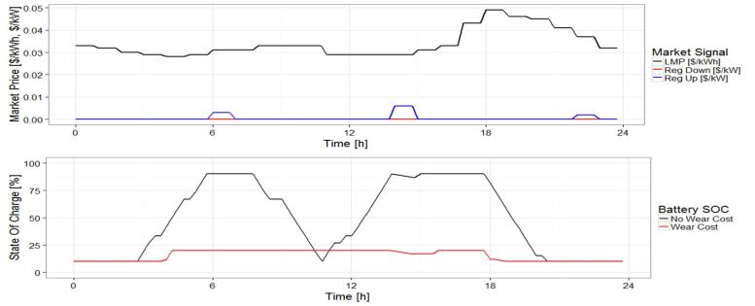
Market Participation Strategy for SDG&E Utility Storage
Description: NREL optimized the dispatch of a battery on a San Diego Gas & Electric (SDG&E) feeder with high-PV penetration across multiple value streams (locational marginal price [LMP] arbitrage, frequency regulation, grid support functions).
Technology: Li-ion battery
Impact: Informed battery market participation strategy to maximize value for SDG&E
Partners: SDG&E
NREL assessed the value the battery provided by enabling deferral of a transformer upgrade through peak shaving on the feeder
Battery market participation strategy: Incorporating degradation into the model changes optimal wholesale market dispatch
Murali Baggu et al. Coordinated Optimization of Multiservice Dispatch for Energy Storage Systems with Degradation Model for Utility Applications. Piscataway, NJ: IEEE Transactions on Sustainable Energy. April 2019. https://doi.org/10.1109/TSTE.2018.2853673.
Notes:
The team analyzed the feeder with high-PV penetration for possible battery storage.
NREL optimized dispatch across multiple battery applications, including locational marginal price arbitrage, frequency regulation, and allocation of inverter capacity for grid support functions. The valuation of grid support is currently being assessed.
The optimized dispatch strategy included the effect of battery degradation. This informed a simplified market participation strategy.
The first graph assesses the value of deferring a transformer upgrade through peak shaving on the
feeder.
Maximum battery utilization would push out the upgrade from year 8 to year 11. This deferral
value is part of the value stack for the battery.

Slide 36
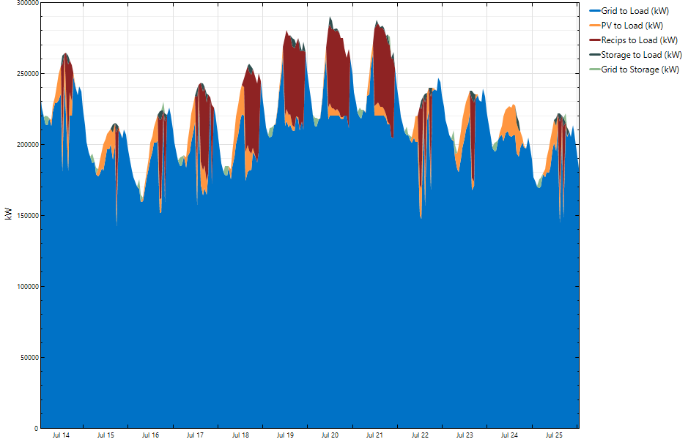
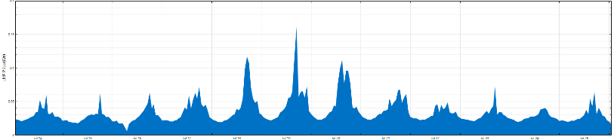
PV+Battery Dispatch for Municipal Utility in PJM
Description: NREL used REopt to determine the optimal dispatch to mitigate coincident peak demand charges.
Technology: Natural gas reciprocating engines and battery storage
Impact: Identified potential for $171 million in savings, including:
92.8-GWh reduction in annual market purchases ($79.6 MM)
53.6-MW reduction in 1 CP demand charges ($39.1 MM)
61.2-MW reduction in 5 CP demand charges ($51.8 MM)
Partner: Utility in PJM
219.9 MW
Model determines optimal dispatch to mitigate coincident peak demand charges; usage during 1CP and 5CP event hours doesn’t exceed 219.9 MW
Natural gas recips and battery storage are dispatched when the market prices are higher than the cost of operating the technologies
Notes:
REopt was used to evaluate the optimal technology mix and dispatch for a municipal utility in PJM’s territory. PJM passes on coincident demand charges to the municipal utilities in their territory. The municipal utility also meets part of their load through purchases on the hour-ahead market. Solar PV, battery storage, and natural gas reciprocating engines could provide up to $171 million in life cycle savings by reducing the 1- and 5-hour coincident peak charges (REopt considers both the PJM load and municipal utility load) and reducing market purchases (REopt considers the hourly market pricing).

Slide 37
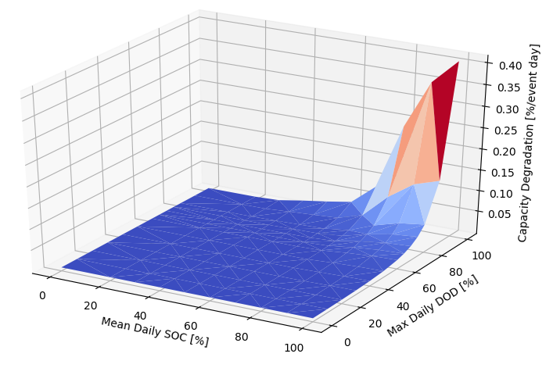
Health-Conscious
Battery Economics
Description: NREL evaluated the economic impact of health-conscious battery controls that consider the trade-off between operational value and degradation cost.
Technology: Storage
Impact: Evaluated battery sizing and operational decisions considering degradation impacts. Findings are being validated through battery pack testing at NREL and will then be integrated into Eaton controls approaches.
Partner: Eaton
Degradation increases with maximum depth of discharge and high mean state of charge
Notes:
REopt is now being integrated into control systems to provide health-conscious control strategies to dispatch the battery for maximum economic gain, taking into account the costs of cycling, temperature, and resting state of charge.
Detailed, non-linear NREL loss models (e.g., Kandler et al.) are evaluated at hundreds of points and then implemented into REopt as a gridded surface, where operation is constrained using special ordered sets (SOS type II).
Both calendrical and cyclical degradation mechanisms have been incorporated in a linear fashion.

Slide 38



Evaluating Centralized vs. Decentralized
Microgrid Options for Military Installations
Description: NREL performed an integrated microgrid feasibility analysis for three U.S. military installations to support U.S. Army energy resilience requirements.
Technologies: Solar PV, battery storage, CHP, chillers (adsorption and centrifugal), hot- and cold-water thermal storage, microgrid components
Impact: Developed conceptual design and cost estimate for integrated microgrids to provide energy cost savings and resilience across the three international U.S. military installations.
Addressed electric vs. heat and resiliency vs. cost prioritization for CHP operation
Resulted in successful RFP for optimized microgrid design.
Partners: United States Army Garrison Italy
Electric
grid
Electric load
Installation 1
Cooling load
Heating load
Electric
grid
Electric load
Installation 2
Cooling load
Heating load
Microgrid extension
Electric
grid
Electric load
Installation 3
    NREL. “REopt Identifies and Evaluates Microgrid Options for the U.S. Army Garrison Italy.” Accessed April 22, 2020. https://reopt.nrel.gov/projects/case-study-usag-italy.html.
Notes:
NREL performed microgrid feasibility and conceptual design analysis for three neighboring U.S. Army Garrison Italy military installations.
Analysis was driven by a requirement to sustain mission-essential loads in the case of a grid outage.
The analysis considered the generation and storage technologies listed on the slide to serve electric load, heating load, and cooling load at each installation, while prioritizing mission-essential loads.
The cost-effectiveness of the technologies is supported by their ability to reduce energy costs during normal, grid-connected mode.
NREL evaluated several possible microgrid configurations, including independent and interconnected microgrids, to identify the most cost-effective pathway to achieve resiliency goals.
NREL REopt analysis estimated lifecycle costs and net present value of technologies and configurations and made recommendations on cost-optimal dispatches. NREL electrical engineers supported conceptual design and recommended controls and communications strategies.

Slide 39
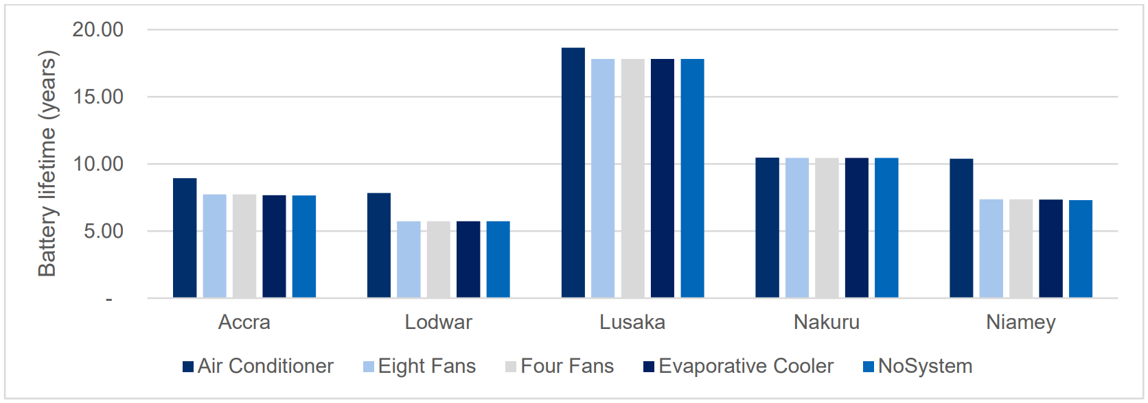
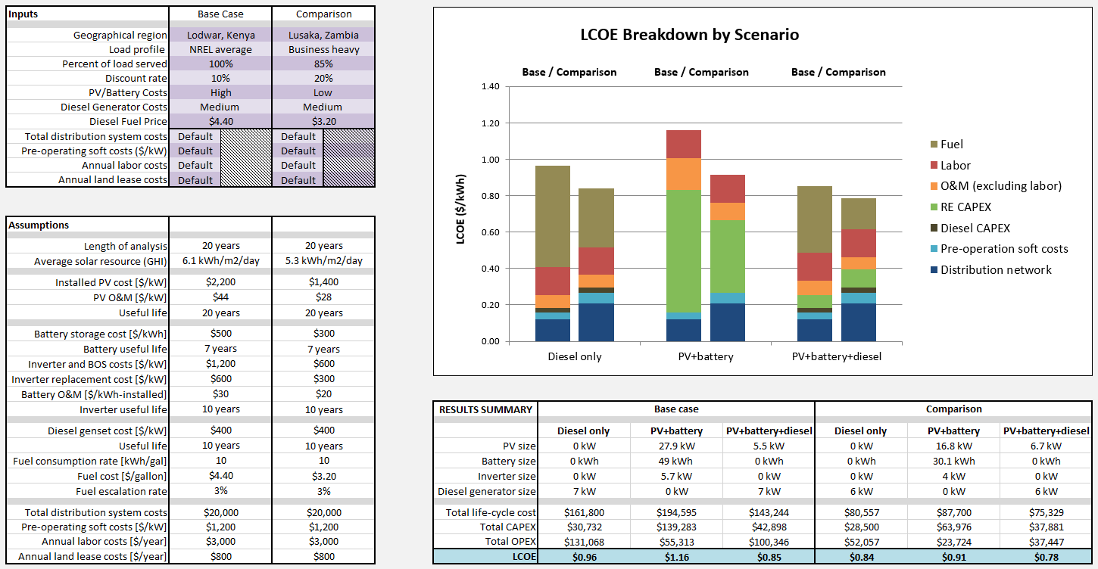
Microgrids for Rural
Energy Access In Africa
Description: NREL used REopt to optimize microgrid designs for systems across sub-Saharan Africa, analyzing the impact of cost trends, technology choices, business models, and regulatory structures to identify least-cost pathways to rural electrification
Technology: PV, li-ion and lead-acid batteries, diesel generation
Impact: Informed rural microgrid design decisions and government policies around energy access goals
Partners: USAID, AMDA, individual microgrid developers, national governments in sub-Saharan Africa
Tools for developers
Eric Lockhart et al. Comparative Study of Techno-Economics of Lithium-Ion and Lead-Acid Batteries in Micro-Grids in Sub-Saharan Africa. Golden, CO: NREL. June 2019. https://www.nrel.gov/docs/fy19osti/73238.pdf.
Tim Reber et al. Tariff Considerations for Micro-Grids in Sub-Saharan Africa. Golden, CO: NREL. February 2018. https://www.nrel.gov/docs/fy18osti/69044.pdf.
Notes:
REopt has been used to optimize rural microgrid design and determine the resulting levelized cost of energy (LCOE) of systems across sub-Saharan Africa. Analysis included optimal technology selection (e.g., lead acid versus lithium-ion batteries), sizing, and dispatch for meeting loads at various reliability levels. REopt-determined LCOEs were compared to existing national tariffs to identify viability gaps and cost reduction pathways. These cost reduction pathways (e.g., the introduction of productive use loads, varying the timing of investment decisions, and various types of government subsidies and grants) are further evaluated in REopt to quantify their individual impact on microgrid costs.
REopt analyses have directly informed decisions made by developers; for example, the battery selection approach for PowerGen (one of the largest microgrid developers in Africa), Standard Microgrid, and Husk Power. REopt results have also been the foundation for policy advice and guidance for several national governments including Ghana, Uganda, and Nigeria.

Slide 40
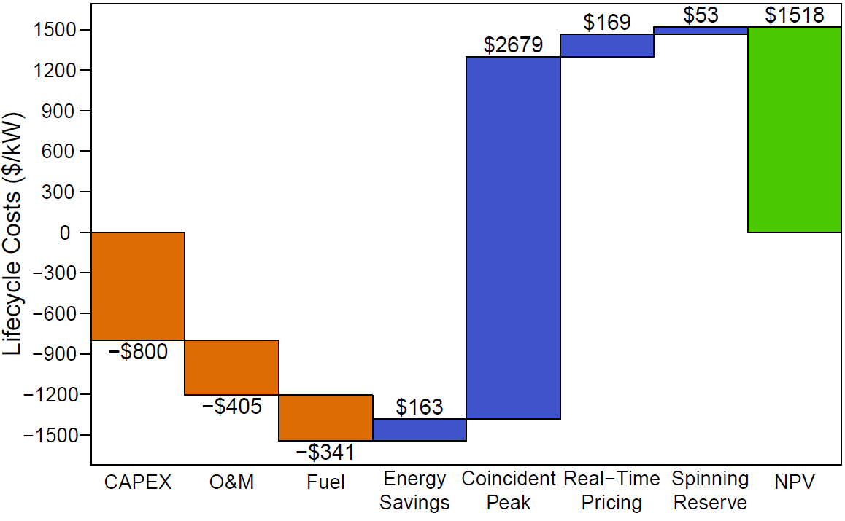
Market Revenues for
Backup Generators
Description: NREL evaluated the value backup generators can provide when used for grid-connected economic dispatch. NREL considered potential revenues from tariff switching, peak shaving, energy self-generation, coincident peak reduction, wholesale real-time pricing, spinning reserve markets, and emergency standby programs.
Technology: Natural gas and diesel generators
Impact: The overall cost of backup
generation can be lowered, but
opportunities vary across the United
States, depending on markets.
Partner: Enchanted Rock
Life cycle costs and revenues ($/kW) for diesel generator
providing grid services in Camden, NJ
Generator Type | Diesel |  |  | Natural Gas
Region | TX | FL | NJ | TX | FL | NJ
CAPEX + O&M ($/kW) | -$1,205 |  |  | -$1,405
Revenues/savings ($kW) | $968 | $1,380 | $3,064 | $1,091 | $1,380 | $3,153
Fuel cost for ($/kW) | -$187 | $0 | -$341 | -$199 | $0 | -$272
NPV ($/kW) | -$425 | $175 | $1,518 | -$513 | -$25 | $1,476
Net present values by region and by fuel type
Ericson, Sean and Dan Olis. A Comparison of Fuel Choice for Backup Generators. Golden, CO: NREL. March 2019. https://www.nrel.gov/docs/fy19osti/72509.pdf
Notes:
This analysis demonstrates traditional backup generators can be used during non-outage periods to generate revenues for the asset owner. The analysts considered a scenario where a supermarket has either a natural gas- or diesel-fueled backup generator in three markets: Texas, Florida, and New Jersey. In Florida, which is a regulated market, the backup generator allows the supermarket to switch to an interruptible tariff which reduces the cost of grid-purchased power. The generator doesn’t run, which creates savings. In the Texas and New Jersey scenarios, the generator is operating at different points in the year to generate market revenues and reduce bill charges.

Slide 41
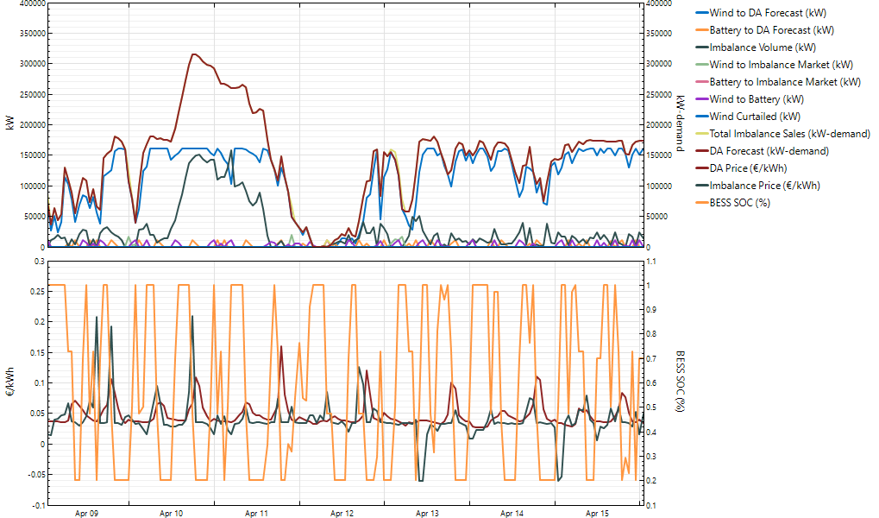
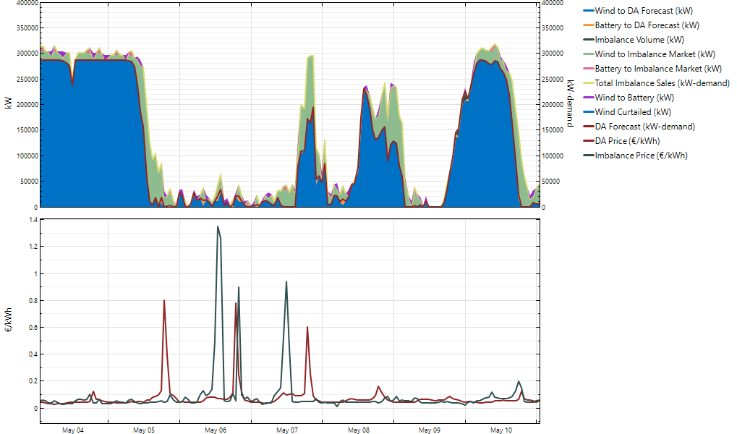
Evaluating Grid-Scale Battery Storage at an Offshore Windfarm in the United Kingdom
Description: NREL assessed stacked value streams for grid-scale battery storage co-located at a windfarm in the United Kingdom:
    Energy arbitrage in day-ahead markets
    Mitigating forecast error penalties in imbalance markets
    Capacity markets
    Avoiding curtailment losses.
    Several sensitivity studies were performed:
    Forecast accuracy
    Battery size
    Battery capital costs
    Grid electricity price escalation rate.
Technologies: Grid-scale battery storage; offshore wind
Impact: Identified market conditions that would make a battery cost effective at an offshore windfarm in the United Kingdom to inform Equinor’s investment decisions.
Partners: Equinor (formerly Statoil)
100%
90%
80%
70%
60%
50%
40%
30%
20%
10%
0%
Output Power as a
Percentage of Total Capacity [%]
Price [£/kWh]
Notes:
Value Stream Descriptions:
Energy arbitrage:
Overview: Equinor bids its wind generation at this site into the Nord Pool N2EX Day Ahead (DA) market. A battery would allow Equinor to store wind generation to sell in future when DA prices are high. This analysis assesses the potential value from such energy arbitrage in the N2EX DA market.
Sensitivity studies: BESS size, BESS cost, electricity price escalation rate.
Data: N2EX DA prices, Equinor generation data
Mitigate forecast error penalties:
Overview: When a generating company does not meet its contracted volume during a given 30-minute period, Elexon charges the generator an imbalance cost for the volume not supplied. If they produce more than their contracted volume, they are compensated at the same price per kWh as the imbalance cost. This analysis evaluates how a battery could help mitigate these imbalance charges.
Sensitivity studies: Forecast accuracy, BESS size, BESS cost, electricity price escalation rate.
Data: Elexon imbalance pricing, Equinor forecast data, Equinor generation data
Avoid curtailment losses
Overview: Curtailment appears to occur due to maintenance activities rather than due to grid congestion. Equinor has confirmed that curtailment losses are not a value stream for a battery.
Data: Equinor curtailment data
Capacity payments
Overview: Although the UK capacity market is currently inactive due to an EU ruling, it will likely be reinstated in the next 1-2 years. The capacity market pays generators to add capacity in order to guarantee adequate supply. The generator is paid a flat annual $/kW, derated based on the type of technology and its likelihood to be available. Generators receiving capacity payments are encouraged to participate in regular energy markets. This analysis explores capacity payments for adding battery to the wind plant.
Sensitivity studies: historical and hypothetical capacity payments
Data: Historical UK capacity market data

Slide 42


Optimizing Off-Grid Water Treatment and Storage
Baseline Model
Added components
Tank Cost Curves
Loads
REopt Model
Description: NREL optimized an off-grid water treatment and storage system on Navajo lands.
Technologies: PV, diesel generator, storage, water treatment and storage
Impact: Identified opportunities to reduce battery size and fuel use by flexing pumping loads and using storage inherent in water tank.
Partner: U.S. Bureau of Reclamation
Power Options and Characteristics
Pump Cost Curves
Size Limitations
Water Treatment Unit Cost Curve
Capital Cost
Operational Cost
Water loads
Pump and treatment power requirements
Optimized System
Equipment size and operating requirements for each process component
Renewable + Generator + Battery + Water Treatment + Pump + Tanks
NREL. “REopt Modeling Informs Design of Off-Grid Water System Under Study for Navajo Nation.” Accessed April 22, 2020. https://reopt.nrel.gov/projects/case-study-usbr.html.
Notes:
This case demonstrates the flexibility of REopt, which allows modification for custom analysis. The U.S. Bureau of Reclamation (BOR) is working with the Navajo Tribal Utility Authority to develop a business case for water vending stations to serve remote Tribal members without running water in their homes. The analysis team worked with BOR to demonstrate an approach to developing designs with the aid of an optimization model. In this scenario, optimization includes determining the size of the components and the system operation required to meet the projected daily water needs. In addition to sizing and dispatching the energy components needed to operate the water vending station, REopt sizes the well pump, water treatment system, and the raw water and freshwater storage tanks to minimize overall system costs.

Slide 43
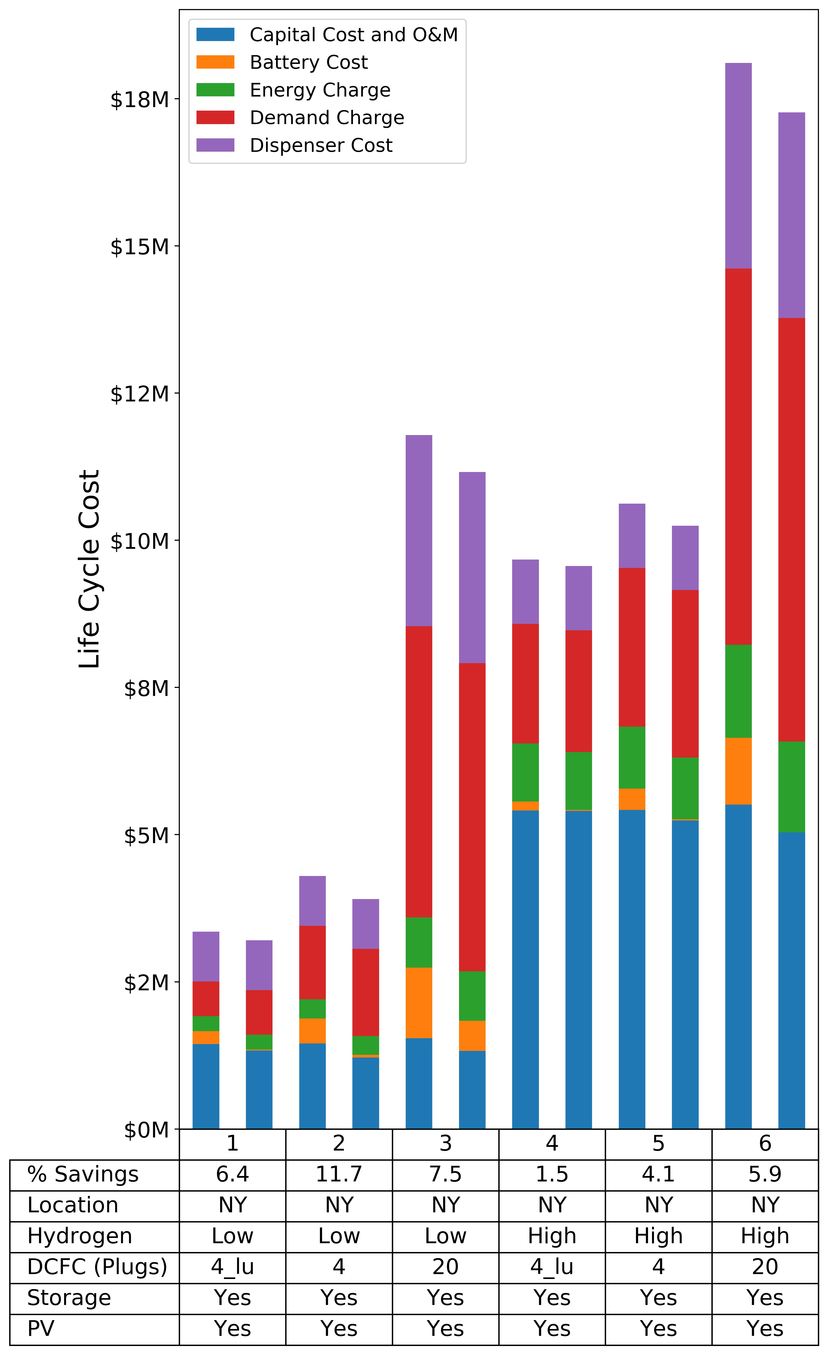
Combined Hydrogen/Electric Fueling Station Financial Screening
Description: NREL analyzed potential for life cycle cost reduction by co-locating DCFC and H₂ fueling stations. Evaluated coordinated system dispatch and renewable integration across a variety of load and utility tariff scenarios.
Technologies: H₂ fueling stations (w/ electrolyzer, compressor, low- and high-pressure storage), DCFC stations, solar PV, battery storage
Impact: Demonstrated savings of over 11% of total life cycle cost for combined H₂ and DCFC system design w/ solar PV
Partners: Car manufacturer, DOE
Combined station
Separate stations
Notes:
The car manufacturer wanted to investigate the potential of collocating DC fast charging (DCFC) electric vehicle (EV) stations with hydrogen vehicle fueling stations.
NREL used its on-campus hydrogen resources to accurately model hourly dispatch of hydrogen production to meet a fueling load.
NREL found that the controllable load of hydrogen production allowed for demand charge savings. Investing in a larger production system gives flexibility to produce at low-peak time periods, reducing demand charges.

Slide 44

DCFC
Station Design
Description: NREL explored solutions that can help make DCFC more affordable for electric vehicle (EV) drivers in the United States:
  Solar PV and/or energy storage (batteries)
  Co-locating DCFC with a commercial building.
Technologies: DCFC, solar, battery storage
Impact: Found 11%−40% of sites can reduce lifetime electricity cost by installing technologies. Co-location often economically preferable but relative savings diminish as load increases.
Partners: DOE Vehicle Technologies Office
Matteo Muratori et al. Technology solutions to mitigate electricity cost for electric vehicle DC fast charging. United Kingdom: Applied Energy, May 2019. https://doi.org/10.1016/j.apenergy.2019.03.061.
Notes:
REopt was used to evaluate the potential for stationary storage, solar PV, and commercial building co-location to lower the cost associated with DC fast charging (DCFC) stations. The load of DC fast charging is “peaky”—and can therefore have a large impact on demand charges. This study considered the load of DCFCs for thousands of utility rates across the U.S. The study found 11%–40% of sites can reduce lifetime electricity costs by installing technologies. Locations where PV appears cost effective correlate with high utility energy charges, and locations where storage appears cost effective correlate with high utility demand charges (see map). Co-location is often economically preferable, but relative savings diminish as DCFC load increases compared to that of a commercial building. For more sparsely utilized DCFC stations, PV and storage have a bigger impact on demand and fixed charges compared to a highly utilized station (see bottom right graph).

Slide 45

Impact of EV Workplace Charging in Minnesota
Description: NREL used REopt to evaluate the economics of workplace EV charging. NREL’s EVI-Pro database used to generate static and flexible EV load profiles.
Technology: EVs, PV, storage
Impact: Found savings from adding PV and storage to EV charging infrastructure and/or flexibility in EV charging times.
Partner: City of Minneapolis
Elgqvist, Emma and Josiah Pohl. Evaluating Utility Costs Savings for EV Charging Infrastructure. Golden, CO: NREL. November 2019. https://www.nrel.gov/docs/fy20osti/75269.pdf.
Notes:
The REopt model was used to assess the opportunity for PV and stationary storage to provide cost savings at an office building in Minnesota that was considering installing EV charging infrastructure. The model was also used to quantify the utility cost savings associated with being able to manage EV charging throughout the day. This analysis used NREL’s EVI-Pro database to generate both the static and “flexible” EV load profiles. The top chart shows the aggregate EV load of 6 different charges for the first week in January. The vehicles were assumed to start charging when upon arrival and continue charging at maximum power until the energy need was met. In the bottom chart, the energy needs of each vehicle needed to be met by the time the vehicle departed, but charging could be spread throughout the day to lower the demand charges.

Slide 46
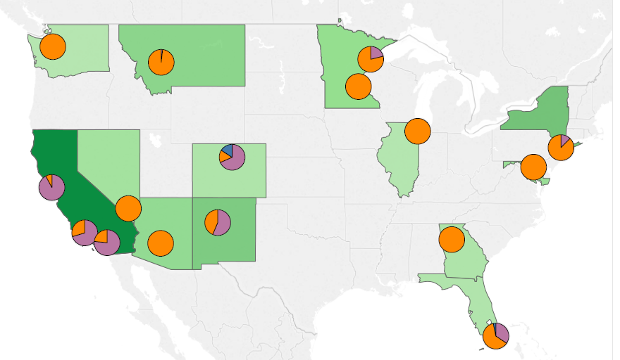

National Economic Analysis of Behind-the-Meter Storage
Description: Analyzed behind-the-meter solar and storage economics across 16 climate zones, 16 building types, 80 utility rate tariffs, and varying technology price points.
Technology: PV, storage
Impact: Identified critical factors in the cost-effectiveness of solar+storage in commercial buildings
Partner: DOE Solar Energy Technologies Office
Joyce McLaren et al. Solar-plus-storage economics: What works where, and why? Netherlands: Electricity Journal. January–February 2019. https://doi.org/10.1016/j.tej.2019.01.006.
Notes:
NREL evaluated the economics of behind-the-meter storage for 16 building types in 16 climate zones across the country under 80 common utility rate tariffs.
We identified key markets where PV, storage, or PV+storage was economical today, or was expected to become economically viable in the future as technology costs decrease.
Results indicate utility rate tariff structures are a key driver of PV+storage economic viability; load profile is less important.
This project also explored the impact of valuing resilience on project economics and found that valuing resilience can increase the size of optimal PV+storage systems and improve affordability.

Slide 47
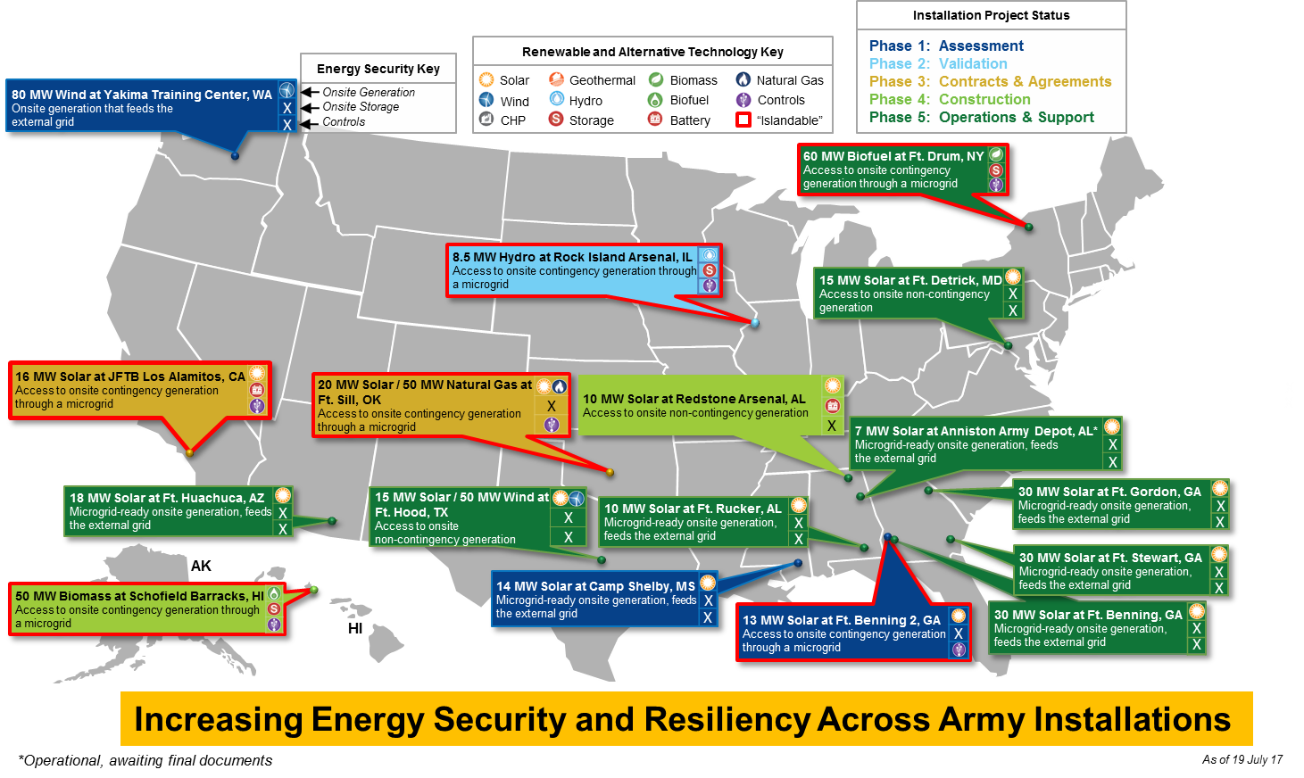
Deploying Cost-Effective Efficiency,
Renewable Energy, and Storage
Description: NREL is working with the Army Office of Energy Initiatives to evaluate renewable energy and storage projects across 100 Army bases. NREL is prioritizing technically and economically feasible projects and assisting in project development.
Technology: PV, wind, CHP, biomass, natural gas, storage, microgrids
Impact: Identifying cost-effective renewable energy, storage, and microgrid projects to reduce Army energy cost and increase installation resilience
Partners: U.S. Army Office of Energy Initiatives
NREL. REopt Screenings Catalyze Development of Hundreds of Megawatts of Renewable Energy for Federal Agencies. Golden, CO: NREL. April 2017. http://www.nrel.gov/docs/fy17osti/68219.pdf.
Notes:
NREL has worked with the DoD for over 10 years to identify renewable energy and storage projects to provide clean, economic, resilient energy to bases.
REopt was used to conduct portfolio-wide screenings of renewable energy and storage technologies at all DoD sites, as well as more detailed site-specific analysis at select sites.
REopt analysis has led to over 260 MW of renewable energy projects in development at DoD sites.
NREL continues to provide analysis and project development support to implement resilient energy projects across DoD.

Slide 48
Identifying and Prioritizing Projects Across a Portfolio
Description: NREL evaluated 700 sites for Time Warner Cable to identify and prioritize technically and economically feasible renewable energy and storage projects and estimate the cost of meeting renewable energy goals.
Technology: PV, wind, ground-source heat pump, storage
Impact: Identified cost-effective renewable energy and microgrid projects to meet Time Warner Cable energy goals for reduced energy use, reduced energy cost, and increased resilience.
Partners: Time Warner Cable, Inc.
Economically Viable PV Projects Across TWC Portfolio
Sites Evaluated | 696
Sites with Cost-Effective PV | 306
Size | 38.79 MW
NPV | $37 million
Allison Richards et al. 2016. Portfolio Analysis of Renewable Energy Opportunities. Philadelphia PA: SCTE/ISBE Cable-Tec Expo. September 26–29, 2016. https://www.nrel.gov/docs/fy17osti/67281.pdf.
Notes:
The cable industry has a goal to reduce energy costs by 25%, energy intensity by 15%, and grid dependence by 10%.
NREL worked with Time Warner Cable to identify and prioritize opportunities for PV, wind, ground-source heat pumps, and storage across 700 cable sites.
NREL identified opportunities for 39 MW of cost-effective renewable energy at about 300 of the 700 sites, which, if implemented, would save Time Warner Cable $37 million over the 25-year life cycle.
At a select group of sites with the best economics, NREL identified how renewable energy and storage could be incorporated alongside existing diesel generators and uninterruptible power supply (UPS) units to increase the resilience of cable sites.

Slide 49
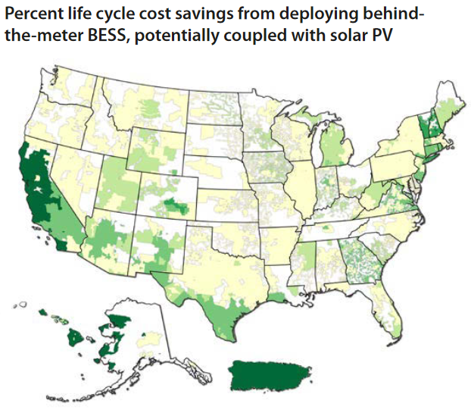
Where Does Solar and Storage Make Sense?
Description: NREL evaluated thousands of combinations of utility territories, solar resources, climate zones, and capital costs to identify scenarios where battery storage is cost-effective across the United States.
Technology: Solar PV and Li-ion battery storage
Impact: Solar-plus-storage systems generate greater savings across more tariff rates and more geographic locations than storage alone.
Partners: Federal Energy Management Program
This map shows where in the United States there is potential for cost savings from implementing a behind-the-meter storage system with solar PV, compared to purchasing all electricity from the utility. Areas in green indicate percentage life cycle cost savings (including utility costs as well as capital and operations and maintenance costs) of the deployed systems. Areas in yellow indicate that the area was evaluated, but a system would not provide life cycle cost savings. Image from NREL
NREL. Where and When Does Solar Plus Storage Make Sense for Commercial Buildings? Golden, CO: NREL. October 2020. https://www.nrel.gov/docs/fy21osti/77112.pdf.

Slide 50
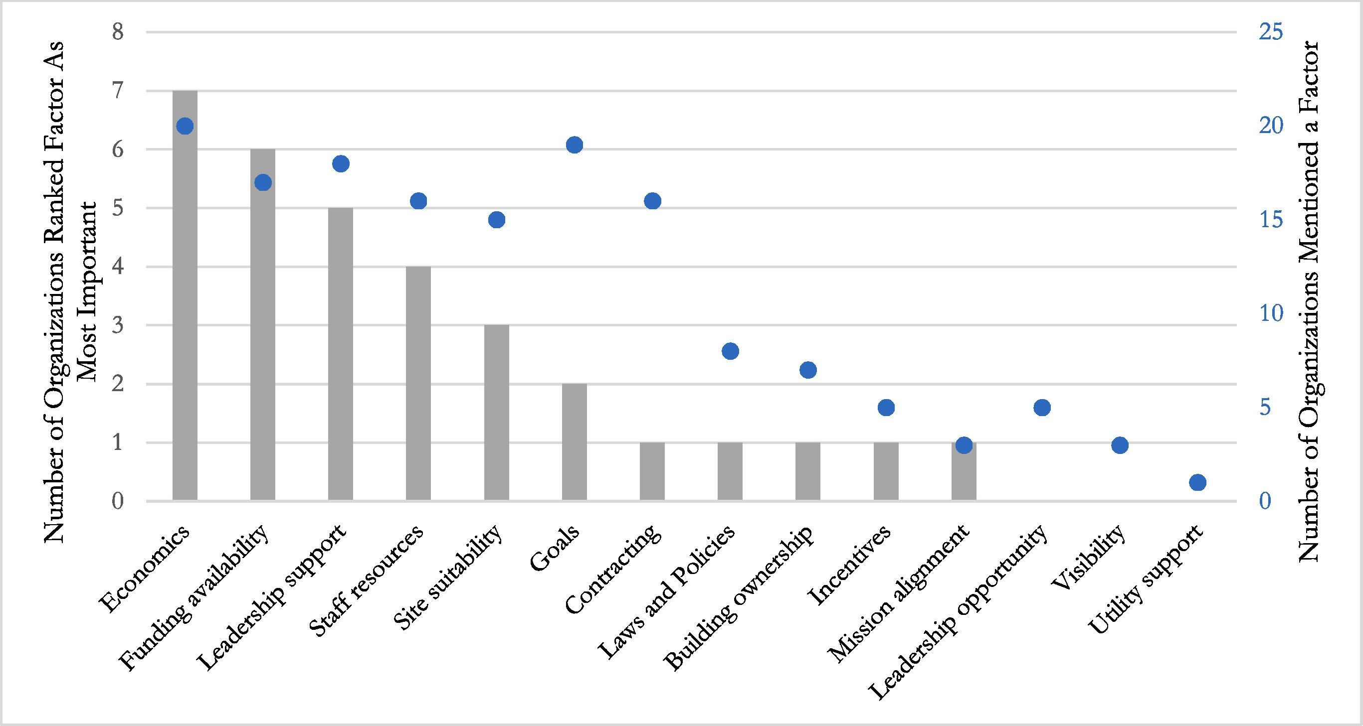
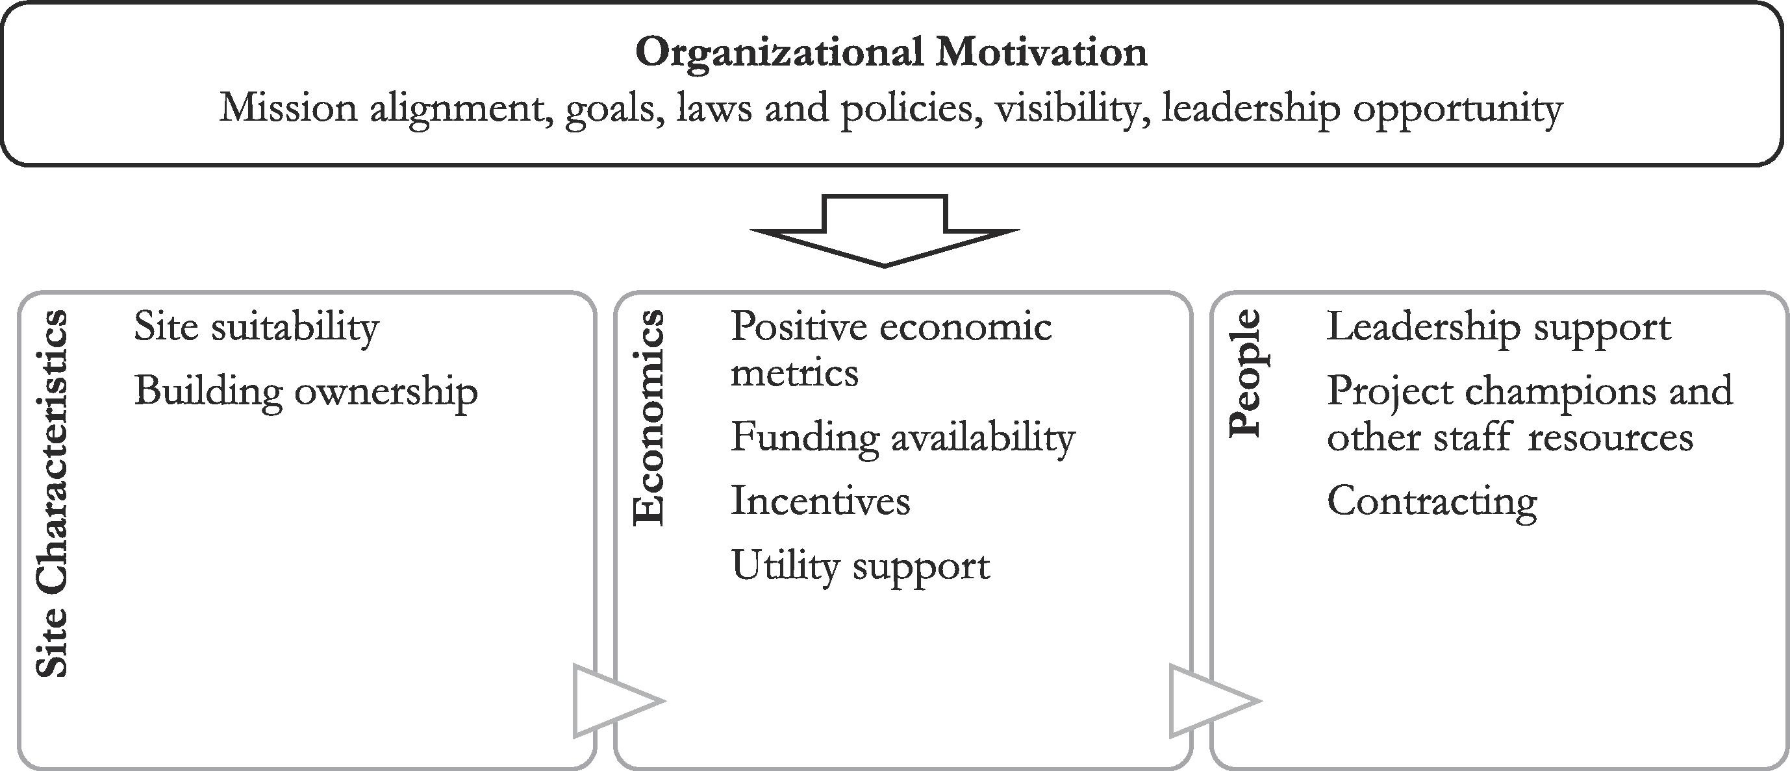
REopt Gap Analysis
Description: Exploring gaps between optimal model solutions and technology deployment using results from interviews with 20 federal, state, and city government agencies that have used REopt to inform energy decisions.
Technology: Renewable energy and battery storage
Impact: Key factors include economics, funding availability, and leadership support; factors present in stage gates where factors in earlier stages must be satisfied first. Suggested improvements include tool improvements, results communication, and additional resources.
Partners: Federal Energy Management Program, state, local, federal government agencies
Count of number of organizations that mentioned a factor and the number of organizations that ranked a factor as most important
Factors typically present in stage gates, where factors in earlier stages must be satisfied first.

Slide 51
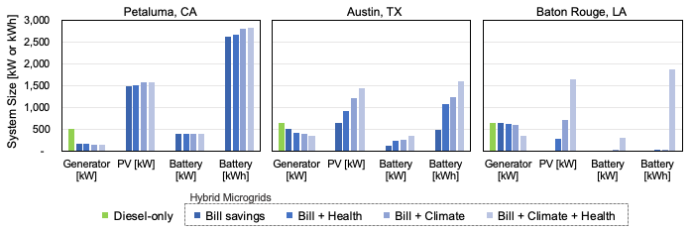
Looking Beyond Bill Savings to Equity in Microgrid Deployment
Cost-optimal system sizes across locations and optimization scenarios. Smaller diesel generators and larger PV and storage systems become cost-optimal as health and climate costs are incrementally included within the life cycle cost calculation.
Description: The value of microgrids is often measured by economic savings and resilience; here we quantify broader costs and benefits, including utility bill savings, value of resilience, social cost of carbon, public health costs, and jobs associated with the construction and operation of microgrids.
Technology: Solar PV, battery storage, diesel generators
Impact: When climate, health, resilience, and job creation are considered, cost-optimal microgrids include more renewable generation, leading to a 52%−82% reduction in emissions and diesel fuel use. The net present values grow by $10−16 million, indicating potential for greater microgrid deployment if energy justice values are incorporated in decision-making. These findings may be useful to communities as they seek to strengthen resilience to natural disasters while also improving public health, meeting climate goals, and providing economic opportunity for residents.
Partners: Federal Energy Management Program
Anderson, Kate, Amanda Farthing, Emma Elgqvist, Adam Warren. 2022. “Looking Beyond Bill Savings to Equity in Renewable Energy Microgrid Deployment”, Renewable Energy Focus Volume 41: pages 15-32. https://doi.org/10.1016/j.ref.2022.02.001.

Slide 52
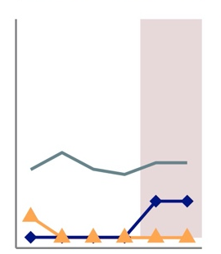
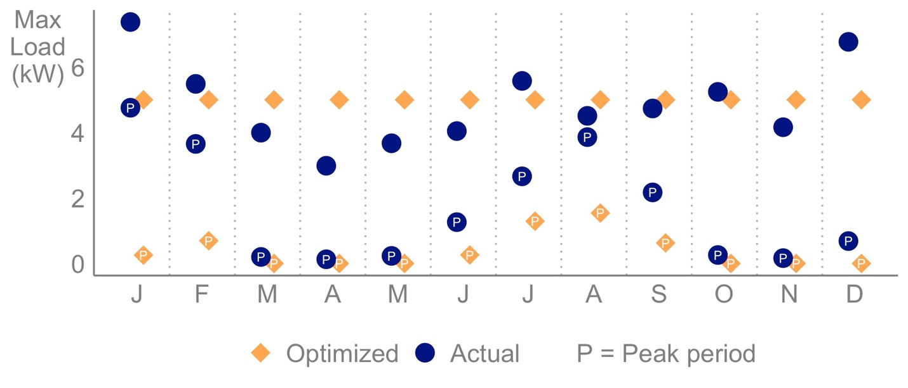
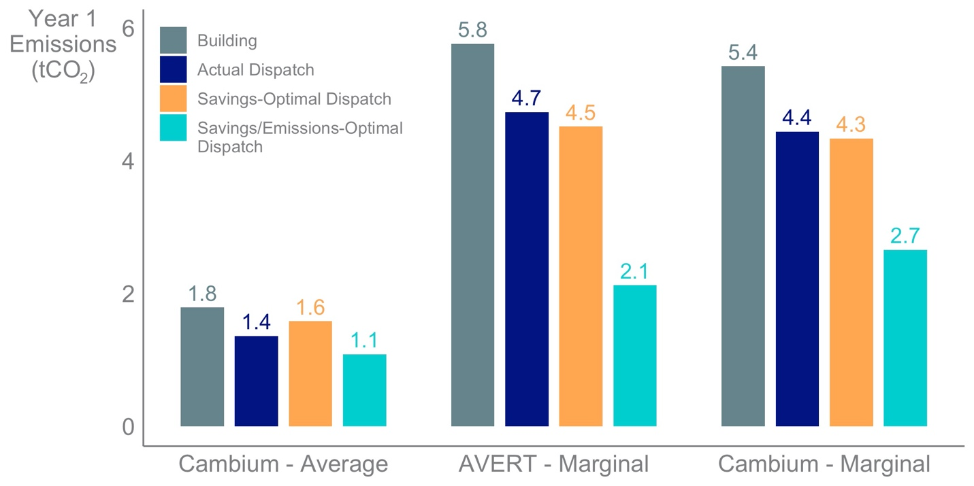
Lessons From Observed and Modeled Solar-Plus-Storage Systems
Description: Utilizing actual data from new-construction homes with solar PV and battery storage systems, NREL evaluated differences in optimal system operations and sizes to inform improvements to dispatch strategy improvements and future technology deployment.
Technology: Solar PV and Li-Ion battery storage
Impact: Demand charges can be reduced significantly by moderating the battery dispatch across the whole peak period. The dispatch could be modified to reduce emissions without sacrificing cost savings.
Partners: Solar Energy Technology Office,
sonnen Inc.

Slide 53
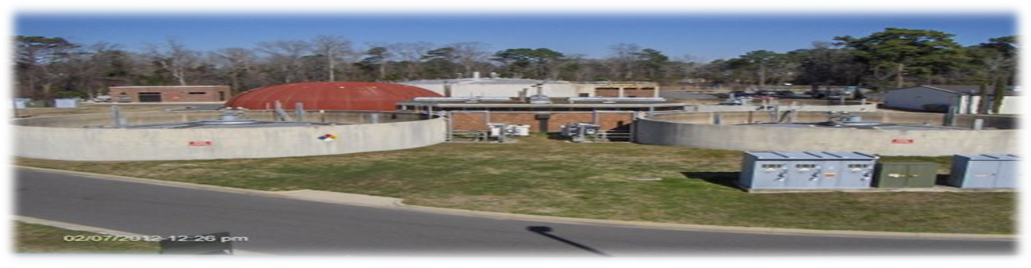
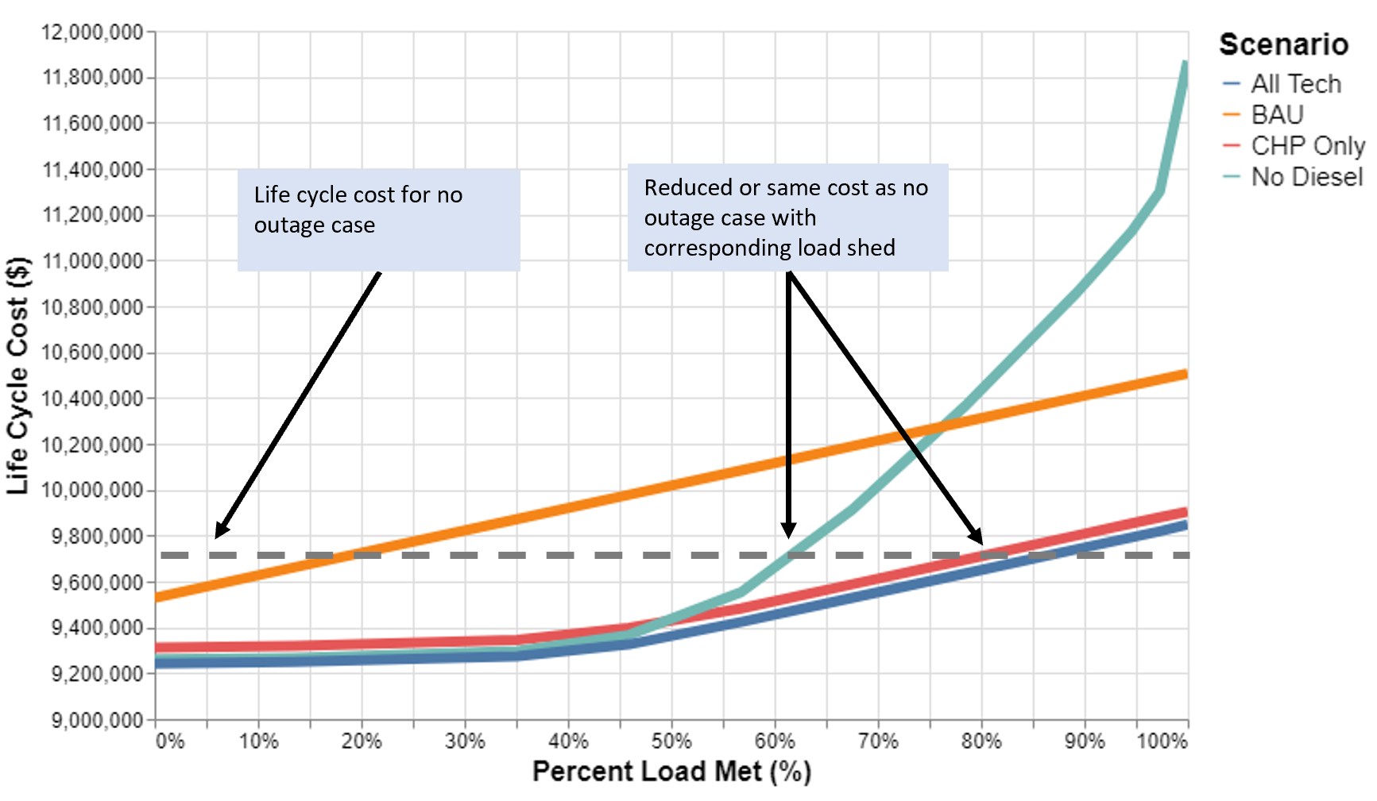
Balancing Cost and Resilience With CHP at Wastewater Treatment Facility
Description: NREL evaluated opportunities for CHP and other DERs to provide cost savings and resilience benefits to the Northside Wastewater Treatment Plant, a critical infrastructure susceptible to power outages.
Technology: CHP fueled by free on-site biogas and natural gas, diesel generator, solar PV, battery storage
Impact: Building a hybrid CHP-PV-storage system reduces life cycle cost of energy for the site by 3% ($301,000 over 25 years).
If load can be reduced during the outage by storing and deferring wastewater treatment, required system sizes and costs decrease.
60% of the load can be met in the No-Diesel scenario, and 80%−85% in the CHP-Only or All-Technologies scenario, at no additional life cycle cost, compared to the business-as-usual (BAU) no-outage case.
Partners: DOE Advanced Manufacturing Office
Northside Wastewater Treatment Plant. Source: CFPUA

